Slide 1


Simple Banking Application
SQL-Based Data Analysis & Optimization
Submitted by: Swarupi Lingayat

Slide 2






PROJECT OBJECTIVES
DATA RETRIEVAL
SQL OPERATIONS
INSIGHT & ANALYSIS
Efficiently fetching Customers, transactions, branches, loans and account branches data using optimized SQL queries.
Mastering core operations including JOINs, GROUP BY, HAVING clauses, and subqueries.
Analyzing result sets to identify user performance trends and improve quiz structures.

Slide 3
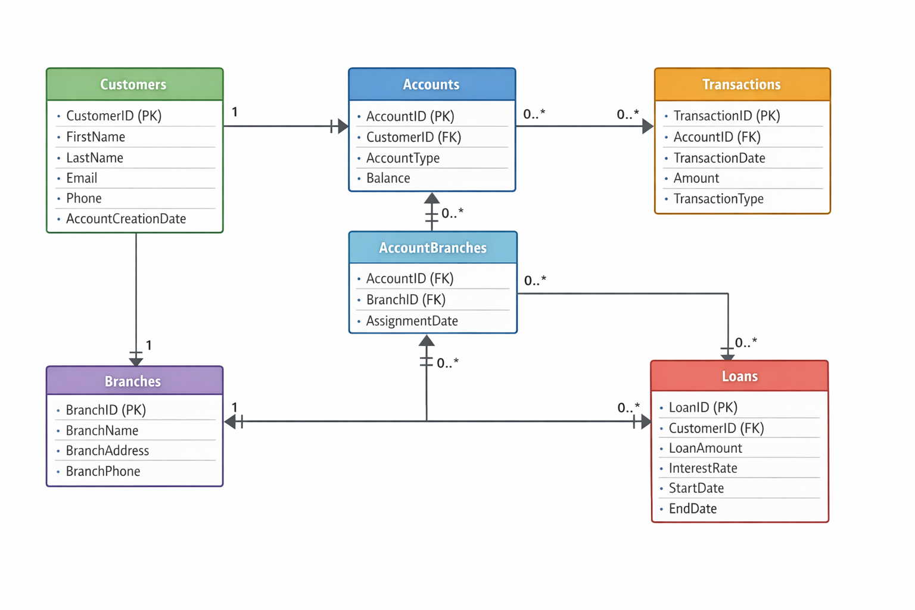
The EER (Enhanced Entity–Relationship) diagram provides a clear and organized view of how data flows and is linked within the system.

Slide 4
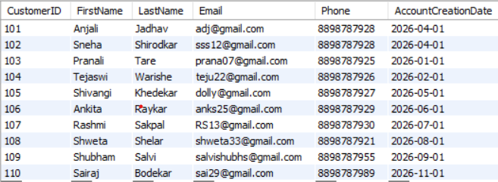
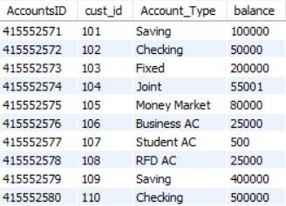
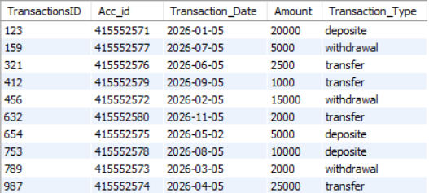
Insert Records:
Customers
Accounts
Transactions

Slide 5
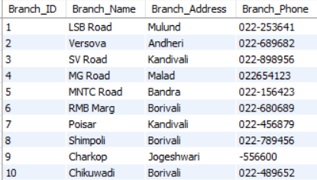
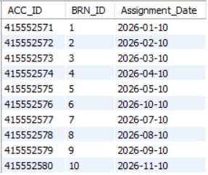
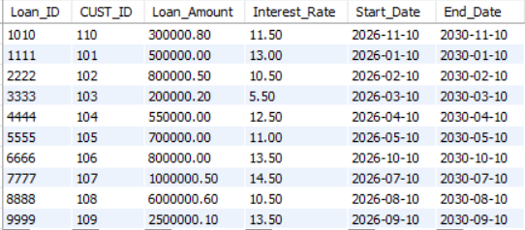
Branches
Account Branches
Loans
ANALYSIS:
The records show a fully functional banking system involves a simple banking application, covering customers, accounts, transactions, branches, account-branch assignments, and loans

Slide 6
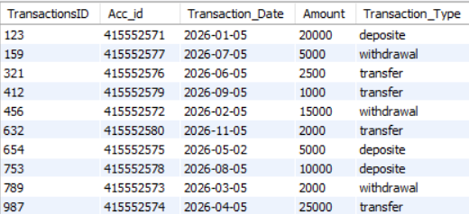
#3). Write a query to select all transactions from the Transactions table where the Amount is greater than $500.
QUERY-
Select * from Transactions where Amount > 500;
OUTPUT-
ANALYSIS-
This query retrieves all rows from the Transactions table where the Amount column has a value greater than 500.

Slide 7

#4) Write a query to select all Accounts where the Balance is between $1000 and $5000 and the Account Type is 'Checking'.
QUERY-
select * from accounts where balance between 1000 and 50000 and Account_Type='Checking';
OUTPUT-
ANALYSIS-
This query retrieves all accounts of type Checking where the balance is within the range of 1,000 to 50,000. here only one account type is checking so displaying one record.

Slide 8
#5) Write a query to select all Customers whose LastName starts with 'J'.
QUERY-
select * from customer where LastName like 'j%';
OUTPUT-
ANALYSIS-
This query retrieves all rows from the Customers table where the LastName begins with the letter “J”. Here only one LastName start with ‘J’ so displaying only one record.

Slide 9
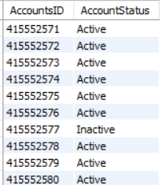
#6) Write a query to select AccountID and a new column AccountStatus from the Accounts table. If Balance is greater than $1000, set AccountStatus to 'Active', otherwise 'Inactive'
QUERY-
select AccountsID,
case
when balance > 1000
then 'Active’
else 'Inactive’
end as AccountStatus
from accounts;
OUTPUT-
ANALYSIS-
This query classifies each account into two categories based on its balance:
Active → Balance greater than 1000
Inactive → Balance less than or equal to 1000
Add new column as AccountStatus where store active and inactive account status based on balance.

Slide 10

#7) Write a query to find all Customers who have a balance in their accounts greater than the average balance of all accounts. Use a subquery to find these CustomerIDs.
QUERY-
select cust_id, balance from accounts where balance >(select avg(balance)from accounts);
OUTPUT-
ANALYSIS-
This query identify all customers whose account balance is greater than the average balance across all accounts.
We get here two columns cust_id and balance.
The subquery >(select avg(balance)from accounts) calculates the average balance of all accounts.
The outer query compares each account’s balance against that average.

Slide 11
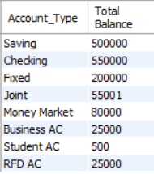
#8) Write a query to get the total Balance for each AccountType. Group the results by AccountType.
QUERY-
select Account_Type, sum(balance) as 'Total Balance’
from accounts
group by Account_Type;
OUTPUT-
ANALYSIS-
This query calculates the total balance for each Account_Type.
Here adds up all balances for each account type and grouped by account type, so we get one column per account type

Slide 12

#9) Write a query to get the total number of accounts for each Customer, but only include customers who have more than 2 accounts. Use the HAVING clause.
QUERY-
select cust_id,count(AccountsID)
from accounts
group by cust_id
having count(AccountsID)>2;
OUTPUT-
ANALYSIS-
This query will return a list of cust_id values along with the number of accounts they hold, but only for customers with 3 or more accounts. Here No customer is available who have more than 2 accounts.

Slide 13
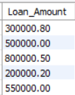
#10Write a query to select the top 5 customers with the highest LoanAmount.
QUERY-
select Loan_Amount
from loans
limit 5;
OUTPUT-
ANALYSIS-
This query returns only the first 5 rows.

Slide 14
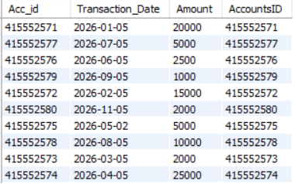
#11Write a query to join Transactions with Accounts to get a list of all transactions with AccountID, TransactionDate, and Amount.
QUERY-
select t.Acc_id,
t.Transaction_Date,
t.Amount,
ac.AccountsID
from transactions t join accounts ac
on t.Acc_id=ac.AccountsID;
OUTPUT-
ANALYSIS-
Here we start with transaction table with aliasing it t and Connect each transaction to its corresponding account using the account ID.
Return the account id transaction date and amount from accounts table
Acc_id from transaction table and AccountsID from accounts table

Slide 15
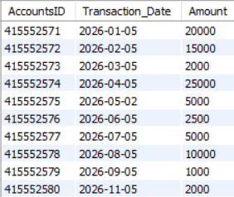
#12) Write a query to get a list of all Accounts and any associated Transactions. Include accounts that might not have any transactions.
select a.AccountsID,t.Transaction_Date,t.Amount
from Accounts a
left join transactions t
on a.AccountsID = t.Acc_id;
QUERY-
OUTPUT-
ANALYSIS-
This query uses a LEFT JOIN between Accounts and Transactions, which ensures that all accounts are listed, even if they don’t have any transactions. Bring in transaction details for each account. If an account has no transactions, the transaction columns will show as NULL.

Slide 16
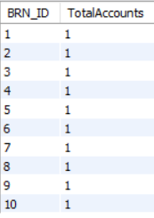
#13) Write a query to get the total number of accounts for each branch. Use an INNER JOIN between AccountBranches and Branches, and group by BranchID.
QUERY-
select b.BRN_ID,count(ab.ACC_ID) as 'TotalAccounts’
from ac_branches ab
inner join ac_branches b
on ab.BRN_ID=b.BRN_ID
group by b.BRN_ID;
OUTPUT-
ANALYSIS-

Slide 17

#14) Write a query to find all Branches that manage accounts with a total balance of more than $100,000. Use a subquery in the WHERE clause to find these BranchIDs.
QUERY-
select BRN_ID
from ac_branches
where BRN_ID in(select BRN_ID from ac_branches ab join accounts a on ab.ACC_ID=a.AccountsID group by BRN_ID having sum(balance)>100000);
OUTPUT-
Selects branch IDs (BRN_ID) from the ac_branches table.
Joins ac_branches with accounts to link accounts to their branches.
Groups by branch ID so totals can be calculated per branch.
Uses HAVING SUM(balance) > 100000 to filter only those branches whose accounts collectively exceed $100,000 in balance.
ANALYSIS-

Slide 18
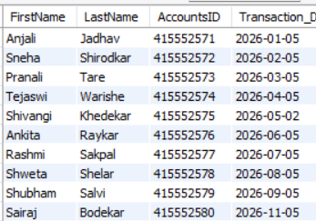
#15) Write a query to list FirstName, LastName, AccountID, and TransactionDate for all transactions. Use INNER JOIN and LEFT JOIN as necessary to get all required details
QUERY-
select c.FirstName,c.LastName,a.AccountsID, t.Transaction_Date
from customer c
inner join accounts a
on c.CustomerID = a.cust_id
left join Transactions t
on a.AccountsID = t.Acc_id;
OUTPUT-
ANALYSIS-
This query get accounts that belong to valid customers. Every row will have a customer’s first and last name with their account ID.
Includes all accounts, even if they don’t have transactions. If an account has no transactions, Transaction_Date will be NULL.

Slide 19

Summary of the Project
Designed and analyzed an simple Banking Application using SQL.
Explored core SQL concepts: SELECT, WHERE, LIKE, JOIN, GROUP BY, HAVING, and Subqueries.
Retrieved customers, accounts, transactions, loans, and branch details
Demonstrated how SQL helps in managing and improving Banking applications.
Overall, the analysis shows that SQL is very powerful for managing Banking data and understanding customers performance. This project helped me gain practical experience in data handling, optimization, and analysis, which are important for any real-life database system.

Slide 20
QUESTIONS?
Thank you for reviewing the Online Quiz Management System.
swarupilingayat@gmail.com

